Slide 1


K. RAMAKRISHNAN COLLEGE OF ENGINEERING
(AUTONOMOUS), SAMAYAPURAM – TRICHY
DEPARTMENT OF ARTIFICIAL INTELLIGENCE AND DATA SCIENCE
CGB1201 - JAVA PROGRAMMING
E-HEALTH MANAGEMENT SYSTEM
PRESENTED BY SUPERVISOR
SUBIKSHA D Mrs. V.SANKARI M.E.,
8115U24AD111 Assistant Professor / AI&DS

Slide 2
PRESENTATION OVERVIEW
Objective
Introduction
Problem Statement
Existing and Proposed Comparision
Architecture Diagram
Modules Used
Conclusion and Future Scope
Output Screenshots
References

Slide 3
OBJECTIVE
The objective of the E-Health Management System is to create a secure and efficient platform for managing patient records, appointments, and communication between patients and healthcare providers.
The system aims to streamline healthcare services by enabling easy appointment scheduling, centralized patient data management, and secure access for both patients and healthcare providers, ensuring improved coordination and better healthcare outcomes

Slide 4
INTRODUCTION
The E-Health Management System is a web-based application designed to digitalize and streamline healthcare services.
The system provides a centralized platform for managing patient information, doctor appointments, medical records, billing, and pharmacy data.
It helps hospitals, clinics, and healthcare professionals access accurate and updated information in real time.

Slide 5
PROBLEM STATEMENT
In traditional healthcare systems, patient data and hospital records are often maintained manually, leading to data duplication, loss of information, and delays in treatment.
Communication between patients, doctors, and administrative staff is inefficient, and there is no centralized platform to manage appointments, prescriptions, or reports.
These issues result in poor patient experience, increased workload for staff, and difficulty in accessing medical history when needed.

Slide 6
EXISTING AND PROPOSED COMPARISION
EXISTING SYSTEM:
Medical records are stored manually on paper files or separate computers.
Patient information, diagnosis, and reports are not centrally connected.
Appointment booking must be done in person or through phone calls.
PROPOSED SYSTEM:
Digital platform with centralized electronic health records (EHR).
All patient data accessible from a single secure database.
Online appointment booking through web or mobile app.

Slide 7
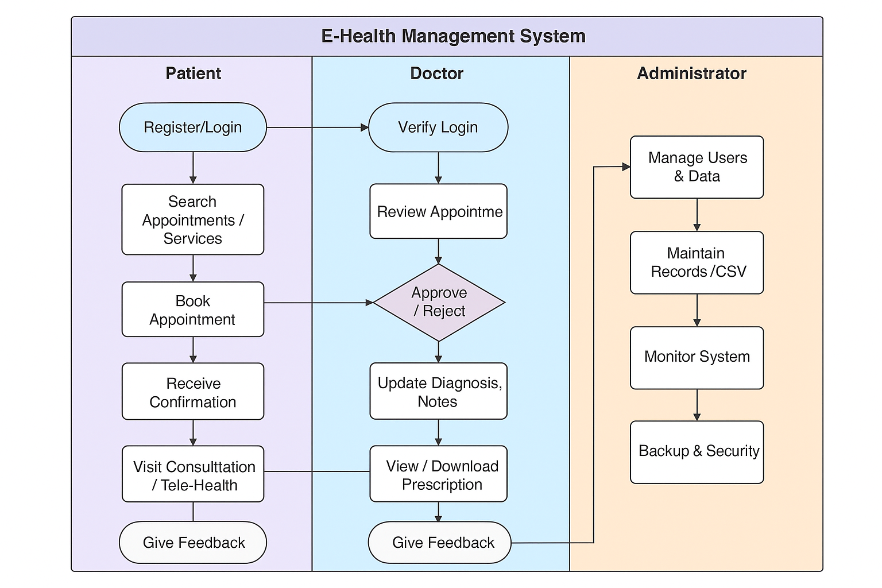
ARCHITECTURE/FLOW DIAGRAM

Slide 8
MODULES USED
Patient Management Module -- Handles patient registration, profile creation, and medical history.
Doctor Management Module – Manages doctor profiles, schedules, and specializations.
Appointment Scheduling Module – Allows patients to book, reschedule, or cancel appointments.
Medical Records Module – Stores and retrieves patient treatment history, lab results, and prescriptions.

Slide 9
CONCLUSION
Transformative Solution: Revolutionizes healthcare management.
Secure and Efficient: Safeguards patient records and streamlines processes.
Enhanced Coordination: Improves collaboration between patients and providers.
Better Engagement: Empowers patients to take an active role in their care.

Slide 10
FUTURE SCOPE
Integration with IoT Devices
Real-time monitoring of patients’ vital signs using wearable health devices (e.g., heart rate, blood pressure, oxygen levels).
Artificial Intelligence (AI) and Machine Learning (ML)
Predictive analytics for early disease detection and personalized treatment recommendations.
Mobile Application Development
A mobile-friendly version to allow patients and doctors to access services anytime, anywhere.
Blockchain Technology
For secure and transparent handling of medical records and preventing data tampering.

Slide 11
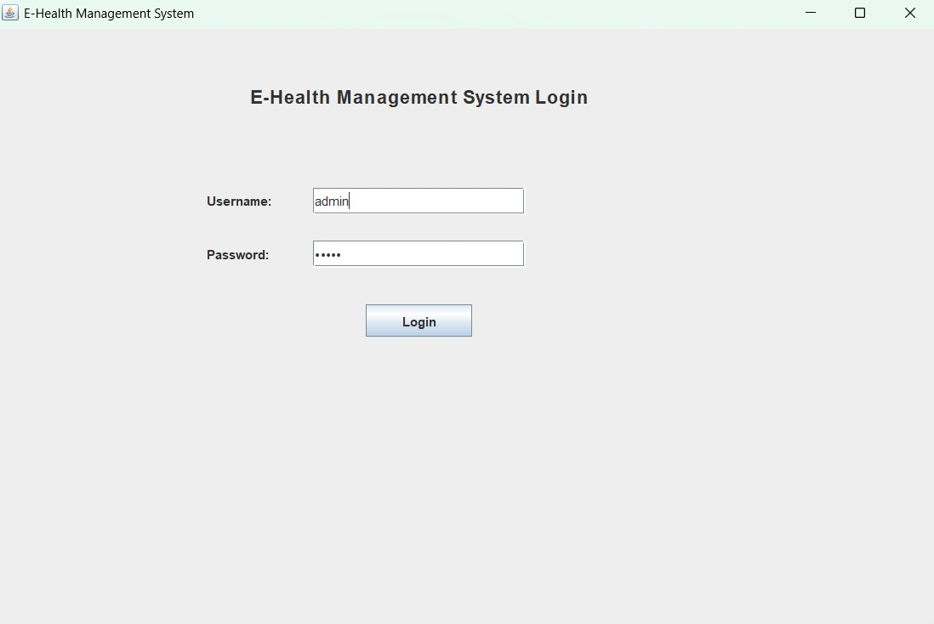
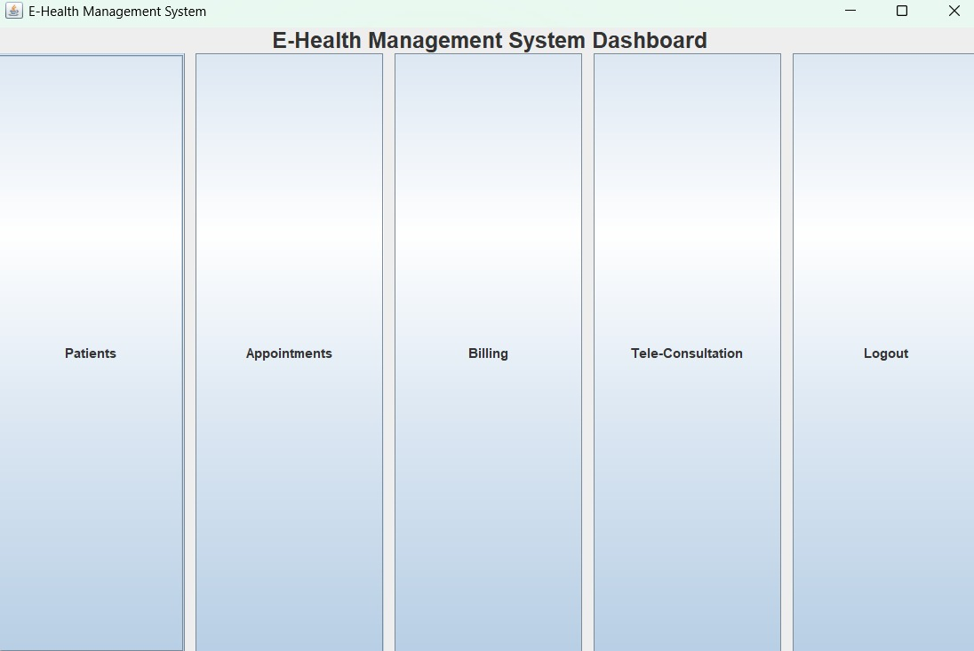
OUTPUT SCREENSHOTS

Slide 12
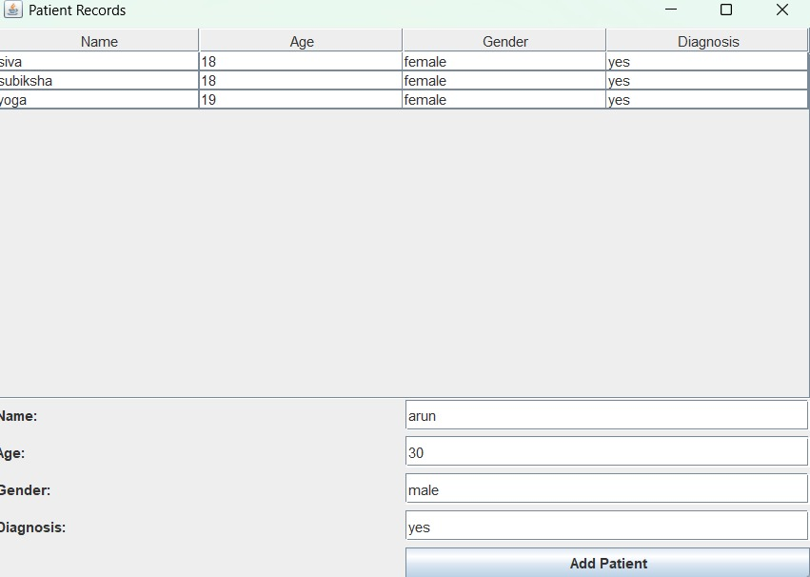
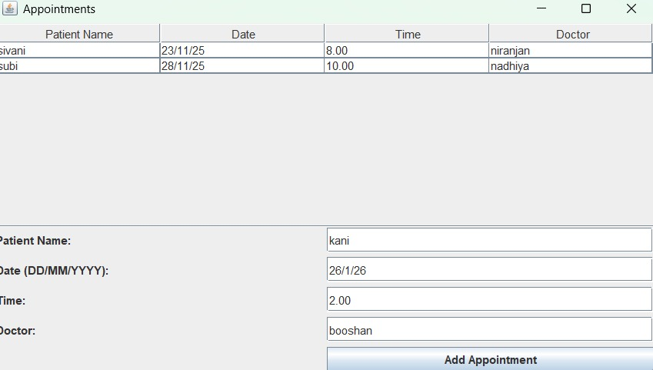
OUTPUT SCREENSHOTS

Slide 13
REFERENCES
World Health Organization (WHO), “Digital Health and E-Health Initiatives,” [Online]. Available: https://www.who.int/ehealth
Springer Publications, E-Health Systems: Theory and Practice, 2019.
ResearchGate, “Smart Health Monitoring and Data Security in E-Health Systems,” 2022.
GeeksforGeeks, “Hospital Management System in Python/MySQL – Implementation Guide,” [Online]. Available: https://www.geeksforgeeks.org

Slide 14


